Slide 1
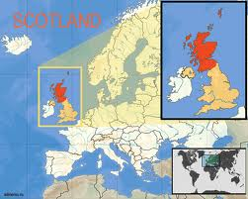
SKOTLAND
Made by:
Ivanka Cherchyk
Iryna Zhapko

Slide 2
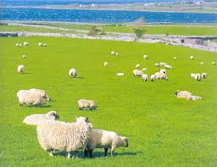
Origin of the name
"Scotland" comes from Scoti, the Latin name for the Gaels. The Late Latin word Scotia ("land of the Gaels") was initially used to refer to Ireland. By the 11th century at the latest, Scotia was being used to refer to (Gaelic-speaking) Scotland north of the river Forth, alongside Albania or Albany, both derived from the Gaelic Alba. The use of the words Scots and Scotland to encompass all of what is now Scotland became common in the Late Middle Ages.

Slide 3
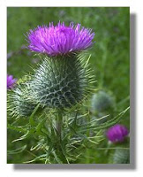
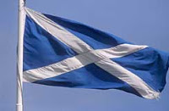
National symbols
The National Flag of Scotland
The flag of Scotland is a blue flag with a white diagonal cross. The Scottish flag is one of the most ancient national flags in the world, his appearance, according to legend, refers to 832, when King Angus Scots before the battle of the Anglo-Saxons saw a sign in the sky in the form of X-like cross, which was crucified Andrew the First Called. Scots at the battle won, and the image of white cross on a sky-blue field has become one of the symbols of Scotland.
The main emblem of the Order - thistle, the national symbol of Scotland. The motto of the Order Nemo me impune lacessit (translated from Latin means "No one touches me with impunity"); same motto is on Royal herbi and some pound coins. Patron of the Order - St. Andrew.

Slide 4
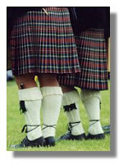
Kilts
Subject menswear, traditional clothes Scotland and kilts usually a piece of fabric that reverse around the waist and secured with straps and buckles, traditional kilt is worn with a special bag for the money and other small things called sporran kilt can be "great" or "small. "Historically, the great kilt was long enough that it can be thrown on the shoulder or vkrytsya it in bad weather. Kilt made ​​of worsted fabric with traditional Scottish pattern of cells and strips - Tartan (in a material known as "plaid"). Today most Scottish kilt used as part of a formal or wedding costumes at the same time, as always, it is worn quite a few people.

Slide 5
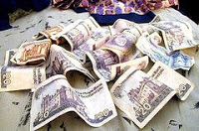
Money Scotland
Scottish pound - the currency of Scotland.
Shotlanskiy pound consists of 100 pence.
At the level of the pound is i shotlanskym British pound sterling.
1 pound = 100 pence. In circulation banknotes of 50, 20, 10, 5, 1 pound coin and 1, 2, 5, 10, 20, 50 pence and 1 i 2 pounds.
While Scotland and part of the UK, it has the right to issue their own banknotes.
Scottish pound is not accepted anywhere but Scotland (UK banks can accept or ignore it at your own discretion), and is not convertible currency.
Banknotes Scotland prized among collectors.

Slide 6
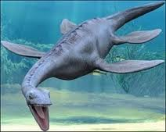
The Loch Ness Monster
The Loch Ness Monster, also Nessie – the name given to a very large animal, supposed to live in Loch Ness in North Scotland.

